Slide 1
Chapter 11 Inheritance
(Sections 11.1-11.6)

Slide 2
Objectives
    To define a subclass from a superclass through inheritance (§11.2).
    To invoke the superclass’s constructors and methods using the super keyword (§11.3).
    To override instance methods in the subclass (§11.4).
    To distinguish differences between overriding and overloading (§11.5).
    To explore the toString() method in the Object class (§11.6).

Slide 3
Inheritance
    Object-oriented programming allows you to define new classes from existing classes. This is called inheritance.
    Inheritance is a powerful and an important feature for reusing software.
    Suppose you will define classes to model circles, rectangles, and triangles. These classes have many common features such as color or dateCreated. What is the best way to design these classes so to avoid redundancy? The answer is to use inheritance.
    Inheritance lets you to define a general class (called a superclass) and later extend it to more specialized classes (called subclasses).
    A subclass inherits accessible data fields and methods from its superclass and may also add new data fields and methods.

Slide 4

Superclasses and Subclasses
GeometricObject
CircleFromSimpleGeometricObject
RectangleFromSimpleGeometricObject
TestCircleRectangle
Run

Slide 5
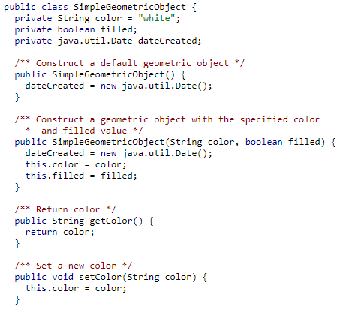
SimpleGeometricObject Class

Slide 6
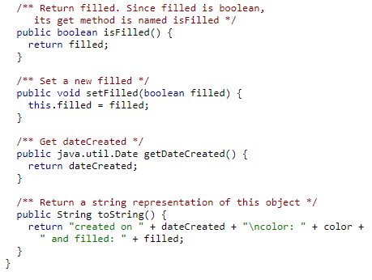
GeometricObject Class

Slide 7
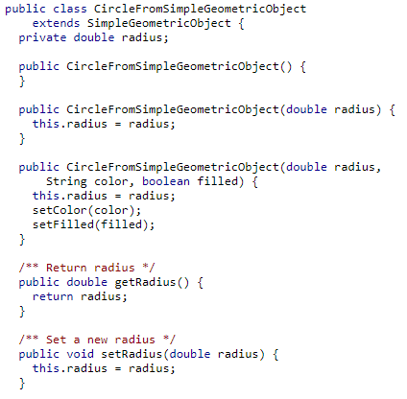
CircleFromSimpleGeometricObject Class

Slide 8
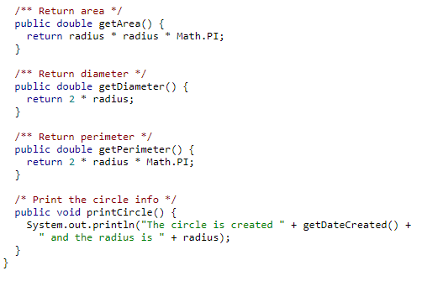
CircleFromSimpleGeometricObject Class

Slide 9
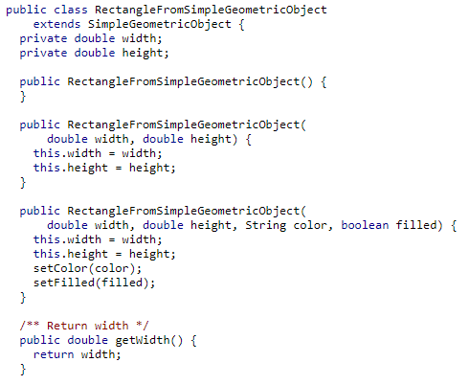
RectangleFromSimpleGeometricObject Class

Slide 10
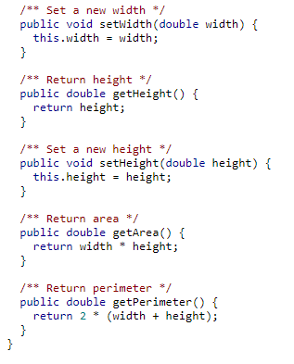
RectangleFromSimpleGeometricObject Class

Slide 11
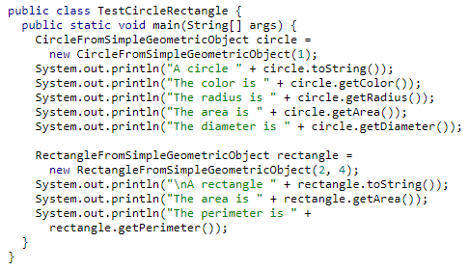
RectangleFromSimpleGeometricObject Class

Slide 12
Single Inheritance
Some programming languages allow you to derive a subclass from several classes. This capability is known as multiple inheritance.
Java, however, does not allow multiple inheritance. A Java class may inherit directly from only one superclass.
Nevertheless, multiple inheritance can be achieved through interfaces, which will be discussed later.

Slide 13
Are superclass’s Constructor Inherited?
No. They are not inherited.
They are invoked explicitly or implicitly.
Explicitly using the super keyword.
If the keyword super is not explicitly used, the superclass's no-arg constructor is automatically invoked.

Slide 14


Superclass’s Constructor Is Always Invoked
A constructor may invoke an overloaded constructor or its superclass’s constructor. If none of them is invoked explicitly, the compiler puts super() as the first statement in the constructor. For example,

Slide 15
CAUTION
You must use the keyword super to call the superclass constructor.
Invoking a superclass constructor’s name in a subclass causes a syntax error.
Java requires that the statement that uses the keyword super appear first in the constructor.
public CircleFromSimpleGeometricObject( double radius, String color, boolean filled) {
  super(color, filled);
  this.radius = radius;
}

Slide 16
Using the Keyword super
The keyword super refers to the superclass of the class in which super appears. This keyword can be used in two ways:
To call a superclass constructor
To call a superclass method

Slide 17
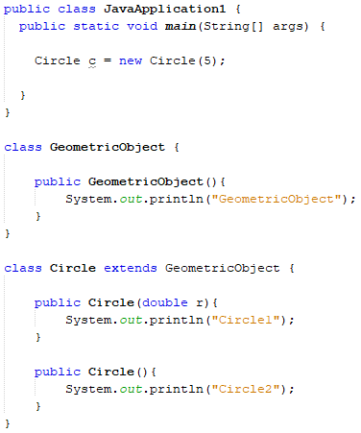
Example – What is the output?

Slide 18
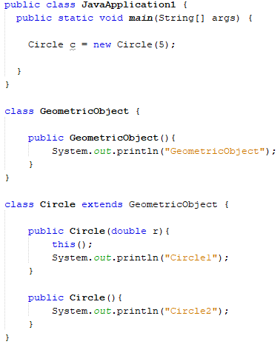
Example – What is the output?

Slide 19
Constructor Chaining
Constructing an instance of a class invokes all the superclasses’ constructors along the inheritance chain. This is known as constructor chaining.
public class Faculty extends Employee {
public static void main(String[] args) {
new Faculty();
}
public Faculty() {
System.out.println("(4) Faculty's no-arg constructor is invoked");
}
}
class Employee extends Person {
public Employee() {
this("(2) Invoke Employee’s overloaded constructor");
System.out.println("(3) Employee's no-arg constructor is invoked");
}
public Employee(String s) {
System.out.println(s);
}
}
class Person {
public Person() {
System.out.println("(1) Person's no-arg constructor is invoked");
}
}

Slide 20
Trace Execution
animation
public class Faculty extends Employee {
public static void main(String[] args) {
new Faculty();
}
public Faculty() {
System.out.println("(4) Faculty's no-arg constructor is invoked");
}
}
class Employee extends Person {
public Employee() {
this("(2) Invoke Employee’s overloaded constructor");
System.out.println("(3) Employee's no-arg constructor is invoked");
}
public Employee(String s) {
System.out.println(s);
}
}
class Person {
public Person() {
System.out.println("(1) Person's no-arg constructor is invoked");
}
}
1. Start from the main method

Slide 21
Trace Execution
animation
public class Faculty extends Employee {
public static void main(String[] args) {
new Faculty();
}
public Faculty() {
System.out.println("(4) Faculty's no-arg constructor is invoked");
}
}
class Employee extends Person {
public Employee() {
this("(2) Invoke Employee’s overloaded constructor");
System.out.println("(3) Employee's no-arg constructor is invoked");
}
public Employee(String s) {
System.out.println(s);
}
}
class Person {
public Person() {
System.out.println("(1) Person's no-arg constructor is invoked");
}
}
2. Invoke Faculty constructor

Slide 22
Trace Execution
animation
public class Faculty extends Employee {
public static void main(String[] args) {
new Faculty();
}
public Faculty() {
System.out.println("(4) Faculty's no-arg constructor is invoked");
}
}
class Employee extends Person {
public Employee() {
this("(2) Invoke Employee’s overloaded constructor");
System.out.println("(3) Employee's no-arg constructor is invoked");
}
public Employee(String s) {
System.out.println(s);
}
}
class Person {
public Person() {
System.out.println("(1) Person's no-arg constructor is invoked");
}
}
3. Invoke Employee’s no-arg constructor

Slide 23
Trace Execution
animation
public class Faculty extends Employee {
public static void main(String[] args) {
new Faculty();
}
public Faculty() {
System.out.println("(4) Faculty's no-arg constructor is invoked");
}
}
class Employee extends Person {
public Employee() {
this("(2) Invoke Employee’s overloaded constructor");
System.out.println("(3) Employee's no-arg constructor is invoked");
}
public Employee(String s) {
System.out.println(s);
}
}
class Person {
public Person() {
System.out.println("(1) Person's no-arg constructor is invoked");
}
}
4. Invoke Employee(String) constructor

Slide 24
Trace Execution
animation
public class Faculty extends Employee {
public static void main(String[] args) {
new Faculty();
}
public Faculty() {
System.out.println("(4) Faculty's no-arg constructor is invoked");
}
}
class Employee extends Person {
public Employee() {
this("(2) Invoke Employee’s overloaded constructor");
System.out.println("(3) Employee's no-arg constructor is invoked");
}
public Employee(String s) {
System.out.println(s);
}
}
class Person {
public Person() {
System.out.println("(1) Person's no-arg constructor is invoked");
}
}
5. Invoke Person() constructor

Slide 25
Trace Execution
animation
public class Faculty extends Employee {
public static void main(String[] args) {
new Faculty();
}
public Faculty() {
System.out.println("(4) Faculty's no-arg constructor is invoked");
}
}
class Employee extends Person {
public Employee() {
this("(2) Invoke Employee’s overloaded constructor");
System.out.println("(3) Employee's no-arg constructor is invoked");
}
public Employee(String s) {
System.out.println(s);
}
}
class Person {
public Person() {
System.out.println("(1) Person's no-arg constructor is invoked");
}
}
6. Execute println

Slide 26
Trace Execution
animation
public class Faculty extends Employee {
public static void main(String[] args) {
new Faculty();
}
public Faculty() {
System.out.println("(4) Faculty's no-arg constructor is invoked");
}
}
class Employee extends Person {
public Employee() {
this("(2) Invoke Employee’s overloaded constructor");
System.out.println("(3) Employee's no-arg constructor is invoked");
}
public Employee(String s) {
System.out.println(s);
}
}
class Person {
public Person() {
System.out.println("(1) Person's no-arg constructor is invoked");
}
}
7. Execute println

Slide 27
Trace Execution
animation
public class Faculty extends Employee {
public static void main(String[] args) {
new Faculty();
}
public Faculty() {
System.out.println("(4) Faculty's no-arg constructor is invoked");
}
}
class Employee extends Person {
public Employee() {
this("(2) Invoke Employee’s overloaded constructor");
System.out.println("(3) Employee's no-arg constructor is invoked");
}
public Employee(String s) {
System.out.println(s);
}
}
class Person {
public Person() {
System.out.println("(1) Person's no-arg constructor is invoked");
}
}
8. Execute println

Slide 28
Trace Execution
animation
public class Faculty extends Employee {
public static void main(String[] args) {
new Faculty();
}
public Faculty() {
System.out.println("(4) Faculty's no-arg constructor is invoked");
}
}
class Employee extends Person {
public Employee() {
this("(2) Invoke Employee’s overloaded constructor");
System.out.println("(3) Employee's no-arg constructor is invoked");
}
public Employee(String s) {
System.out.println(s);
}
}
class Person {
public Person() {
System.out.println("(1) Person's no-arg constructor is invoked");
}
}
9. Execute println

Slide 29
Exercise – Identify Output
class Person {
public Person() {
System.out.println("Person");
}
}
class Student extends Person {
public Student() {
this("Jane");
System.out.println("Student");
}
public Student(String name) {
System.out.println(name);
}
}
public class JavaApplication3 {
public static void main(String[] args) {
Student c = new Student();
}
}

Slide 30
Exercise – Identify Output
class Person {
public Person() {
System.out.println("Person");
}
}
class Student extends Person {
public Student() {
System.out.println("Student");
}
public Student(String name) {
System.out.println(name);
}
}
public class JavaApplication3 {
public static void main(String[] args) {
Student c = new Student("Jane");
}
}

Slide 31
Exercise – Identify Output
class Person {
public Person() {
System.out.println("Person");
}
}
class Student extends Person {
public Student() {
super();
this("Jane");
}
public Student(String name) {
System.out.println(name);
}
}
public class JavaApplication3 {
public static void main(String[] args) {
Student c = new Student();
}
}

Slide 32
Example on the Impact of a Superclass without no-arg Constructor
Find out the errors in the program:
class Fruit {
public Fruit(String name) {
System.out.println("Fruit's constructor is invoked");
}
}
class Apple extends Fruit {
}
public class Test {
public static void main(String[] args) {
Apple a = new Apple();
}
}

Slide 33
Calling Superclass Methods
The keyword super can be used to reference a method in the superclass.
This is particularly used when you are overriding a method from the superclass and now need to call the superclass method.
See example on next slide.

Slide 34
Overriding Methods in the Superclass - Example
class Person {
public String toString() {
return("Person");
}
}
class Student extends Person {
public String toString() {
return(super.toString() + " and Student");
}
}
public class JavaApplication3 {
public static void main(String[] args) {
Student s = new Student();
System.out.println(s);
}
}

Slide 35
NOTE
An instance method can be overridden only if it is accessible.
Thus a private method cannot be overridden, because it is not accessible outside its own class.

Slide 36
NOTE
Like an instance method, a static method can be inherited.
However, a static method cannot be overridden.
If a static method defined in the superclass is redefined in a subclass, the method defined in the superclass is hidden.
The hidden static method can be invoked using the syntax SuperCassName.staticMethodName.

Slide 37
Override annotation
To avoid mistakes, you can use a special Java syntax, called override annotation, to place @Override before the method in the subclass. This annotation denotes that the annotated method is required to override a method in the superclass. If a method with this annotation does not override its superclass’s method, the compiler will report an error.
public class Circle extends GeometricObject {
  // Other methods are omitted
  @Override
  public String toString() {
  return super.toString() + "\nradius is " + radius;
  }
}

Slide 38
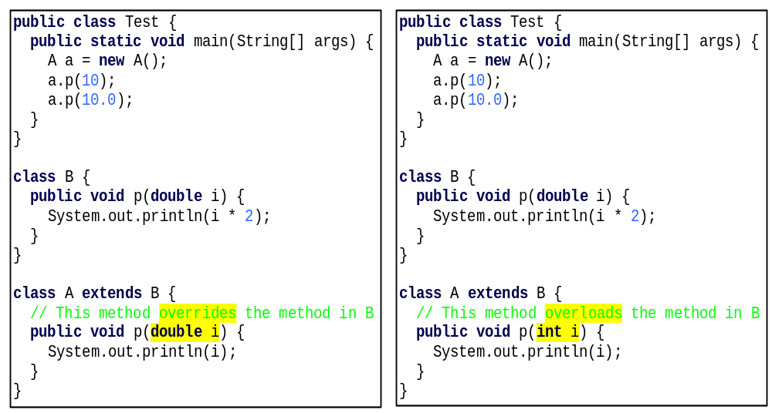
Overriding vs. Overloading

Slide 39

The Object Class and Its Methods
Every class in Java is descended from the java.lang.Object class. If no inheritance is specified when a class is defined, the superclass of the class is Object.

Slide 40
The toString() method in Object
The default implementation of toString() in Object class returns a string consisting of a class name of which the object is an instance, the at sign (@), and a number representing this object.
Student s = new Student();
System.out.println(s.toString());
The code displays something like Student@15037e5 . This message is not very helpful or informative. Usually you should override the toString method so that it returns a digestible string representation of the object.

Slide 41
The protected Modifier
The protected modifier can be applied on data and methods in a class. A protected data or a protected method in a public class can be accessed by any class in the same package or its subclasses, even if the subclasses are in a different package.
Visibility increases in this order:
  private, default, protected, public

Slide 42

Accessibility Summary

Slide 43

Visibility Modifiers

Slide 44
A Subclass Cannot Weaken the Accessibility
A subclass may override a protected method in its superclass and change its visibility to public.
However, a subclass cannot weaken the accessibility of a method defined in the superclass.
For example, if a method is defined as public in the superclass, it must be defined as public in the subclass.

Slide 45
The final Modifier
The final class cannot be extended:
final class Math {
...
}
The final variable is a constant:
final static double PI = 3.14159;
The final method cannot be overridden by its subclasses.

Slide 46
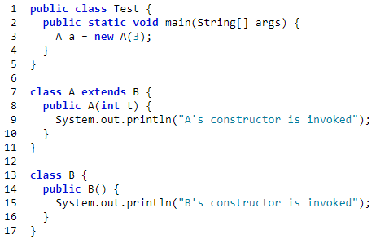
Practice Exercise
What is the output of the following program?

